Slide 1
PHYSICS PROJECT
AUTOMATIC SANITIZER
DISPENSER

Slide 2
MEMBERS OF THE GROUP
D1AD_47-Yash Sarang
D1AD_15-Om Gaydhane
D1AD_37-Manav Pahilwani
D1AD_36-Madhusudhana
D1AD_62-Akshat Tiwari

Slide 3
SENSORS
It can be called as an electronic component which is capable of detecting changes in its environment and send the information to the coupled relay or a microprocessor.
We see the usage of sensors in our daily life.
From the reverse car parking sensors in our automobile to the touch sensitive sensors that are used in the smart phones. A sensor basically works on the change in the input quantity being measured.
A sensor's sensitivity indicates how much the sensor's output changes when the input quantity being measured changes. For instance if we consider infrared sensor, it is triggered only when an object cuts the line of the infrared beam.

Slide 4
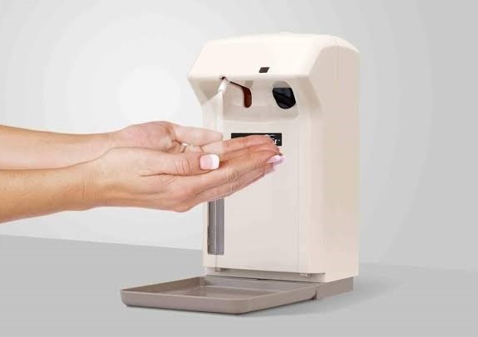
AUTOMATIC SANITIZER DISPENSER

Slide 5
Reason for selecting this as one of our topic for our project:-
Cleanliness is next to Godliness. Sanitizing is one of the best methods of keeping ourselves and our surroundings hygienic. During this pandemic, sanitization has taken a very important role in our lives.

Slide 6
Advantages of automatic sanitizer DISPENSER
One of the biggest advantages of an automatic hand sanitizer dispenser machine is that it offers a required amount that is enough to clean both hands.These required doses are usually sprayed on the hands, which causes minimum to no wastage, unlike manual ones, which releases extra sanitizer at times.
Eliminates a contact point
Manual hand sanitizers require pushing the pump to release sanitizer.Touching the pump can spread a lot of germs, as people with dirty hands also use it.
With touchless hand sanitizer dispensers, there is no common contact point, which means less or no germs will be transferred from one person to another.

Slide 7
COMPONENTS
.
COMPONENT | COST
Proximity Sensor | 90/-
DC Water Pump | 45/-
TIP32C PNP Transistor | 15/-
Aquarium Tubing | 130/-
Old Glass Jar | ---
Old Ball Pen | ---
Sanitizer/Liquid Soap | 100/-
TOTAL COST | 380/-

Slide 8
WORKINg
The proximity sensor senses the hand and the dc pump ejects the alcohol/liquid soap.
It works on power supply.

Slide 9
CONCLUSION
Alcohol hand sanitizers are much more effective than than soaps, and also easy to use .
Non contact dispensing is again important to prevent pathogens and viruses from spreading and finally hand hygiene is most important and must be a part of our daily life.

Slide 10


